Slide 1
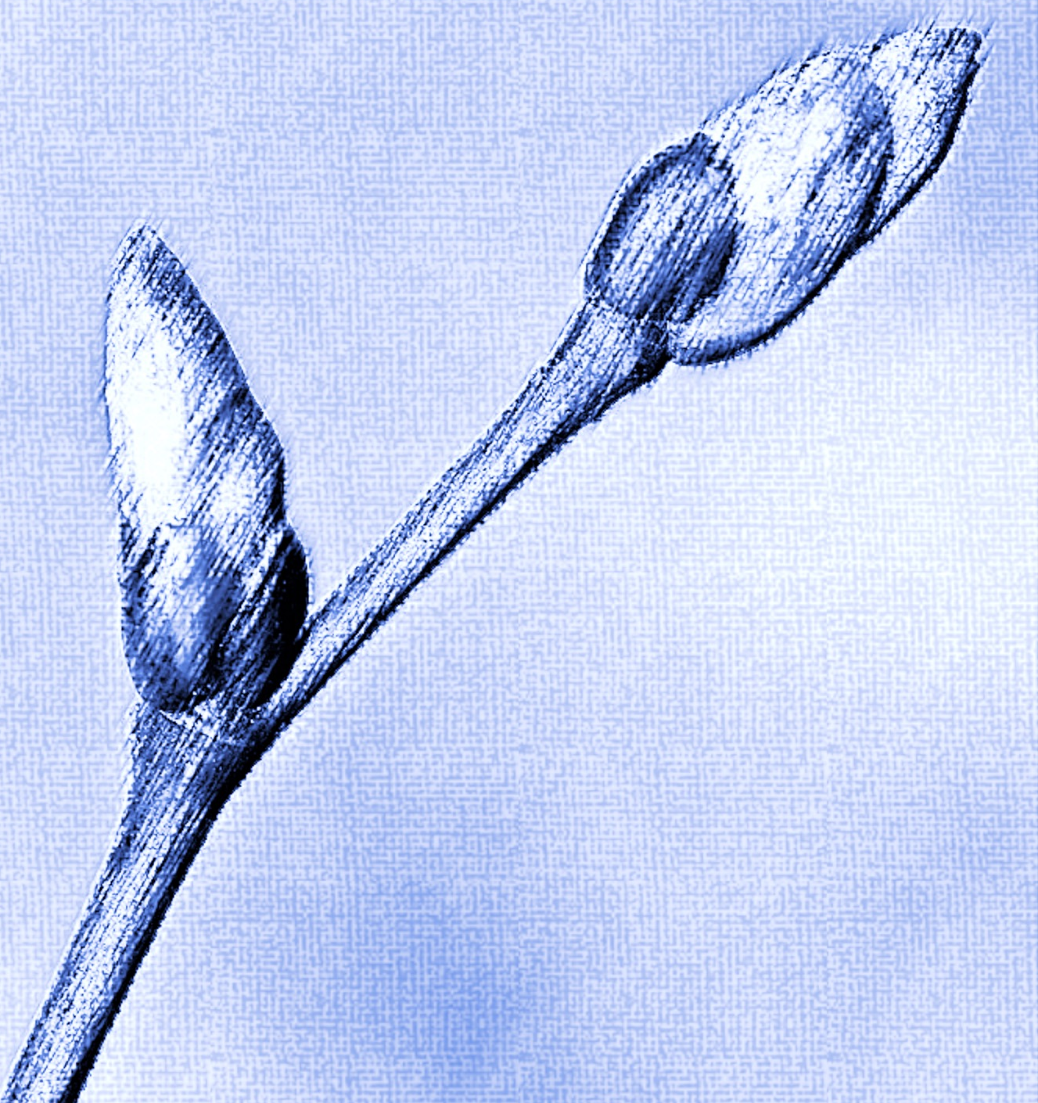
TREE SPOTTERS
Arnold Arboretum

